Slide 1

Tweet-O-Meter: Mapping Twitter Sentiments on the Globe
Rahul Agarwal
Abdus Samad Khan
Bhagya Parekh
Chinmay Kulkarni
Haseeb Jahangir
Ramsey Stephan
Business Analytics Final Project
5/4/2015

Slide 2








Marketing Industry
$14B
$200M
$1.93B
$492M
But….
“40% of the budgets are being wasted” – Rex Briggs, Marketing Guru
$10B
$1.7B
$404M
$1.64B
Notes:
Quoted From: http://adage.com/article/news/marketers-worse-directing-budgets-wisely/235009/
Title: Marketers Are Getting Worse at Directing Their Budgets Wisely
…Briggs Book Finds Advertisers Failing to Spend Sufficiently on Social Media
Currently, the Nielsen rating system is used to evaluate the popularity of TV shows as the basis for setting the prices advertisers pay for TV ad placements. It’s a crude instrument. The system simply measures how many of the 25,000 participating households have their TVs tuned to particular channels at 15 minute intervals.
But what if we added social sentiment to the mix? Marketers would know how millions of people were reacting to their programming in near real time. Those insights could help them decide how much to pay for advertising slots and how to appeal to viewers in their ads.

Slide 3


Tweet-O-Meter Overview
Sentiment Analysis
Uses computational linguistics to identify and extract subjective information
Techniques involve keyword spotting, lexical affinity and statistical methods
Global Mapping
Maps sentiments to geographical locations
Highlights optimal target zones for marketing
Notes:
Naïve Bayes

Slide 4






System infrastructure
GUI
A keyword is passed to our GUI
Server
Query is sent to our server
Twitter
Server pings Twitter to get real time stream of relevant tweets
Analytics
Map
Tweets are passed to our Analytics Engine which computes sentiment score for each tweet
Tweets are plotted on GMaps
Each tweet is color coded using its sentiment score

Slide 5
Sentiment Analytics
Model Training
The classifier was trained on a data set of movie reviews
Tokenization
&
Extraction
The input text is parsed and split into words
Sentiment Score Calculation
Uses the bag of words concept
The sentiment polarity is mapped to each word and assigned to a dictionary
Ambiguous words such as nouns, pronouns are eliminated as they don’t convey any meaning
The final score is calculated using Naïve Bayes Classifier

Slide 6
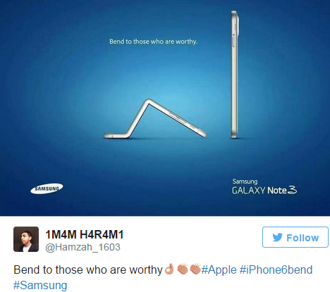
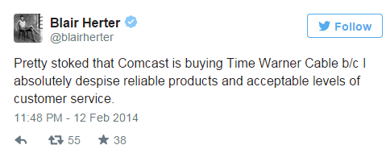
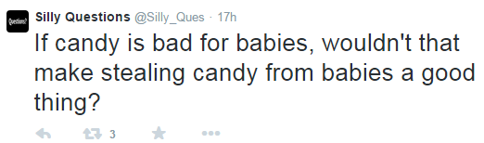
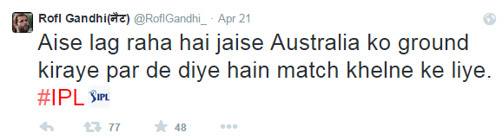
Model Limitations
Sarcasm
Context
Ambiguity
Language

Slide 7

Marketing Strategy for Apple
iPhone 6 released
Samsung Galaxy S6 is going to be released in Q2 ‘15
Apple needs a geographically-targeted Marketing Strategy to stabilize sales
Notes:
Now let’s assume that you’re Apple’s Chief Marketing Officer, Phil Schiller, and you’re presented with this graph of declining iPhone Sales. Q2 ‘15 is about to start and the new Samsung Galaxy S6 will be releasing shortly. Since you’re aware of the significance of social sentiment when allocating a marketing budget, you reach out Tweet-O-Meter to develop a geographically-targeted Marketing Strategy to stabilize sales.

Slide 8


Marketing Mix Matrix
Marketing Budget Allocation Range
Min
Mean
Max
Very conservative marketing campaign
 |  | Positive | Neutral | Negative
 | Positive
 | Neutral
 | Negative
Strong marketing campaign to capitalize on Samsung’s negative sentiment
Vigorous marketing campaign to entice indifferent customers
Notes:
Our Tweet-O-Meter company has developed the following Marketing Mix Matrix to qualitatively specify the marketing budget allocation breakdown based on twitter sentiment for the 2 main rivals – Apple and Samsung.
Firstly, when both Apple and Samsung have a neutral sentiment in a particular geographic region, Apple needs to institute a vigorous marketing campaign here to entice these indifferent customers.
Next, if both Apple and Samsung have an overall positive sentiment in a location, Apple should not spend too much money on advertising/marketing there.
Also, if Apple’s sentiment in a region is neutral whereas Samsung’s is negative, Apple should enforce a stronger-than-average marketing campaign in that region to capitalize on Samsung’s negative sentiment.

Slide 9
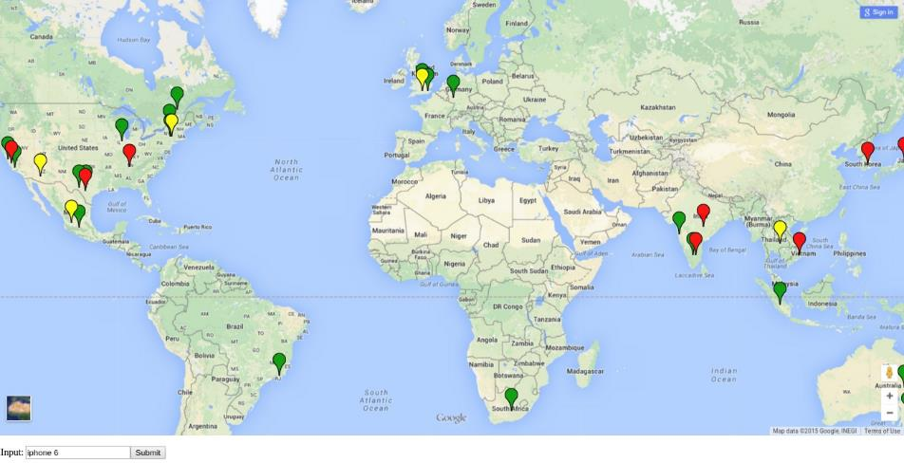
Apple iPhone Sentiment Map
Notes:
Tests were run over a 6 hour period for both
Limited data because:
-Only 1%-2% twitter data is accessible when using the unpaid API (Tweepy) – For the future, we should use the paid Firehose API which provides 100% access to Twitter data
-Language restrictions
-Timezone differences

Slide 10
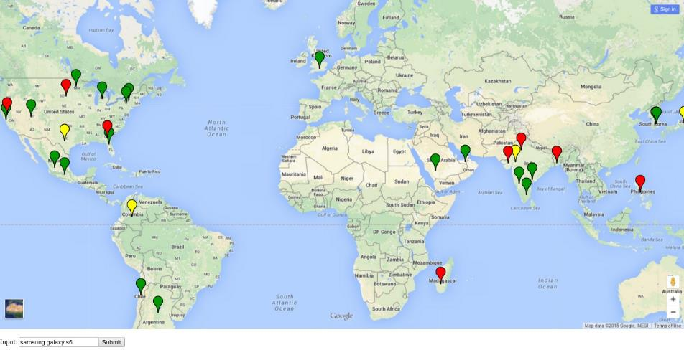
Samsung Galaxy S6 Sentiment Map
Notes:
There seem to be more data points for Samsung since the S6 was in fact revealed just a few weeks ago

Slide 11
Recommended Strategy
Maximize marketing budget allocation in South Asia Region – eg. India, Vietnam and Japan due to predominantly negative iPhone sentiment
Reduce marketing budget allocation in regions such as Australia and UK since they are, on average, loyal Apple customers
Minimize marketing budget in South Korea since it’s the home of Samsung

Slide 12
More Applications
Election Campaign Tours:
Identify neutral states for presidential candidates to target
Determine top voter issues and positions
Flyer Experience Tracking:
Analyzing customer opinion on delays, in-flight entertainment and upgrades to help service their Support division
Movie Production Companies:
Evaluating movie sentiment based on trailer discussions prior to movie release

Slide 13
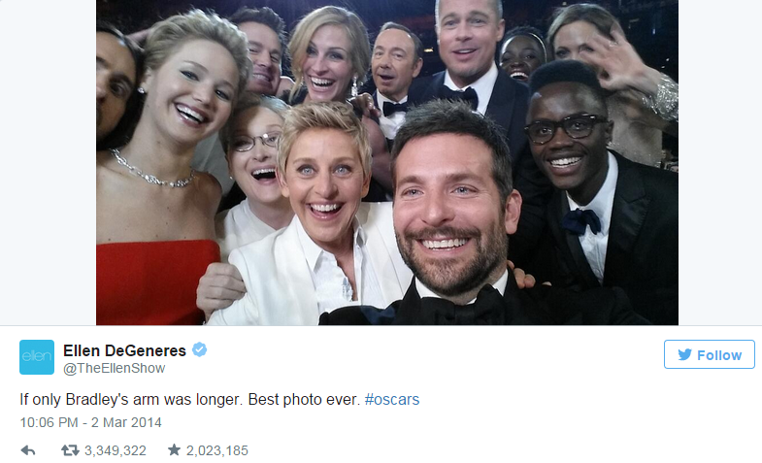
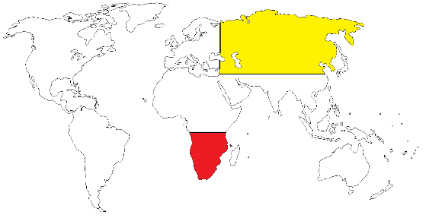
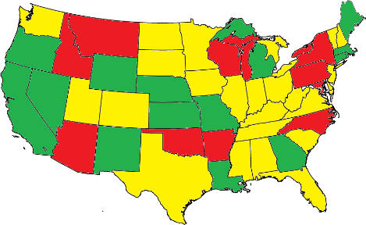
Future Scope
Average sentiment per state/country
Average real-time sentiment per user-defined region
Retweet count as indicator of reliability
Notes:
Provide a numerical average of sentiments of each country or state.
Calculation of average sentiments in real time of a user defined geographical region.
Incorporate retweet count in analytics. We plan to use retweet count as an indicator of reliability of the tweet. Sentiment of a tweet with a higher retweet count will weigh more than one with a lower retweet count when calculating average regional sentiments.

Slide 14
DEMO

Slide 15
THANK YOU

Slide 16
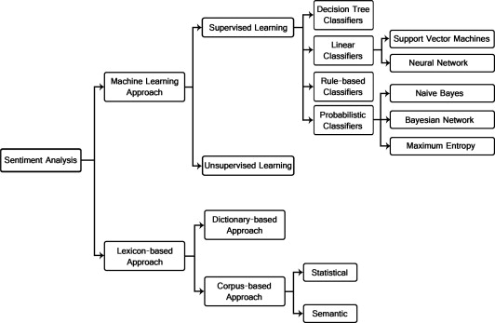
Appendix - Sentiment Analysis Methods

Slide 17

Appendix – Naïve Bayes Classifier
Naive Bayes Classifier:
Naïve Bayes Classifier is a Bayes Classifier, that is it is of the form. $$G\left(k\right)=\underset{k}{argmax}{P\left(G=k|x\right)}$$
Where
$$P\left(G=k|x\right)=\frac{P\left(x|G=k\right)P\left(G=k\right)}{p\left(x\right)}$$
and $x$ represents an instance of the feature vector to be classified. The classifier assumes that each feature is independent of others given the class.
$$P\left(x|G=k\right)=P\left(<x_{1},x_{2},…,x_{p}>|G=k \right)=P\left(x_{1}|G=k\right)P\left(x_{2}|G=k\right)…P\left(x_{p}|G=k\right)$$

Slide 18
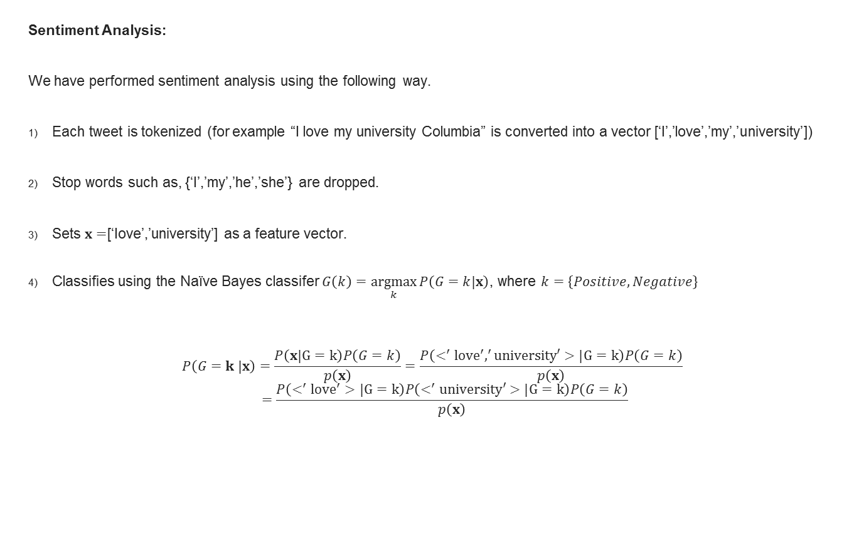
Appendix – Sentiment Analysis Using Naïve Bayes
Sentiment Analysis:
We have performed sentiment analysis using the following way.
Each tweet is tokenized (for example “I love my university Columbia” is converted into a vector [‘I’,’love’,’my’,’university’])
Stop words such as, {‘I’,’my’,’he’,’she’} are dropped.
Sets $x=$[‘Iove’,’university’] as a feature vector.
Classifies using the Naïve Bayes classifer $G\left(k\right)=\underset{k}{argmax}{P\left(G=k|x\right)}$, where $k=\left\{Positive, Negative\right\}$
$$P\left(G=k |x\right)=\frac{P\left(x|G=k\right)P\left(G=k\right)}{p\left(x\right)}=\frac{P\left(<^{′}{love}^{′},^{′}university′>|G=k\right)P\left(G=k\right)}{p\left(x\right)}$$
$$=\frac{P\left(<^{′}{love}^{′}>|G=k\right)P\left(<^{′}university′>|G=k\right)P\left(G=k\right)}{p\left(x\right)}$$

Slide 19
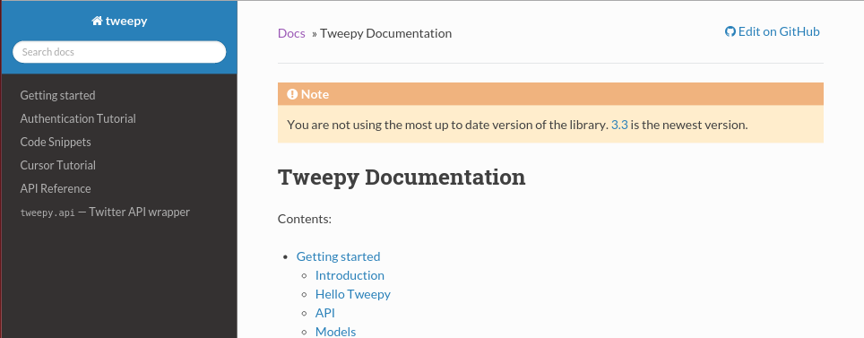
Appendix - Twitter API Explanation
We have used the python based Twitter API “Tweepy” to get real time twitter streaming data.
The API requests keywords. When given a keyword, the API contacts Twitter server and initiates a stream of tweets containing those terms.

Slide 20
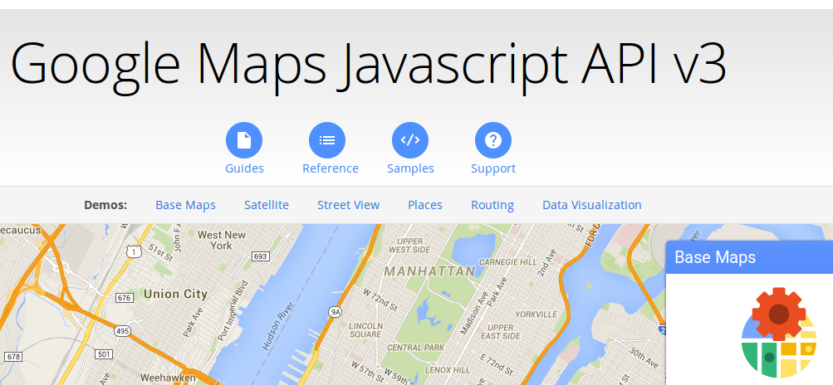
Appendix - Google Maps API Explanation
Once our analytics engine crunches the sentiment scores, it passes the tweet, its score and location as json to our front-end.
There we use Google Maps API to plot those tweets per their location on the world map

